Slide 1

Stock Purchasing Financial Analysis
Project 2
Jabin Barcelo
Derek Herr
Karina Manzo
Kristina Valenzuela

Slide 2
Presentation Requirements
Be at least 8 to 10 minutes long (check with the instructor for the official presentation time).
Describe the core message or hypothesis for your project.
Describe the predictive model chose and why this model was chosen.
Describe the data preparation and model training process.
Describe the techniques used to evaluate the model performance.
Summarize your conclusions and predictions. This should include a numerical summary (what data your model yielded), as well as visualizations of that summary (plots of the final model evaluation and predictions).
Discuss the implications of your findings. This is where you get to have an open-ended discussion about what your findings mean.

Slide 3
Stock Analysis
Hypothesis
We will use 3 key indicators to be able to make stock purchase and sell recommendations based on historical stock pricing data.
Historical Stock Data from Yfinance API
We used a code to generate multiple csv files for a range of the past 5 years
Data Range – 5 years
Train Data – 2016 – 2019
Test Data - 2020

Slide 4
3 Key Signals
MACD (Moving Average Convergence Divergence)
Analysis of the difference between the 12-day & 26-day Exponential Moving Average, overlayed on the 9-day Exponential moving Average. Signals are the points at which these lines cross
RSI (Relative Strength Index)
Evaluation of recent pricing fluctuations to determine whether a security is being overbought or oversold.
Momentum
Acceleration of a security’s price or volume. Relies on short-term movements over fundamental value

Slide 5
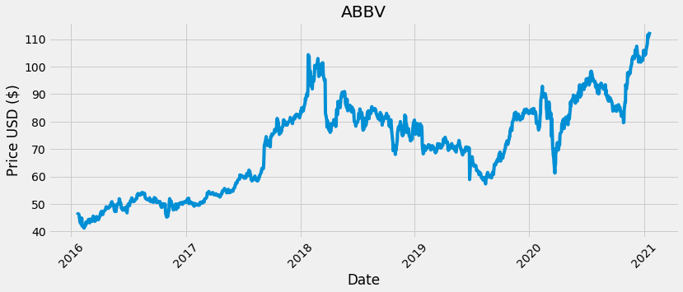
AbbVie Inc (ABBV)
Historical Pricing

Slide 6
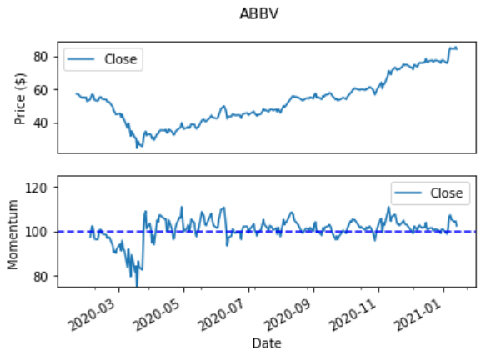
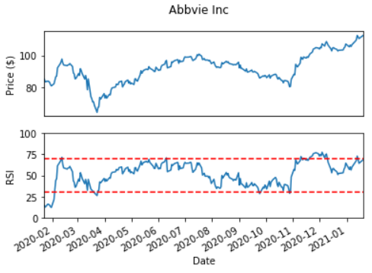
AbbVie Inc (ABBV)
Momentum & RSI

Slide 7
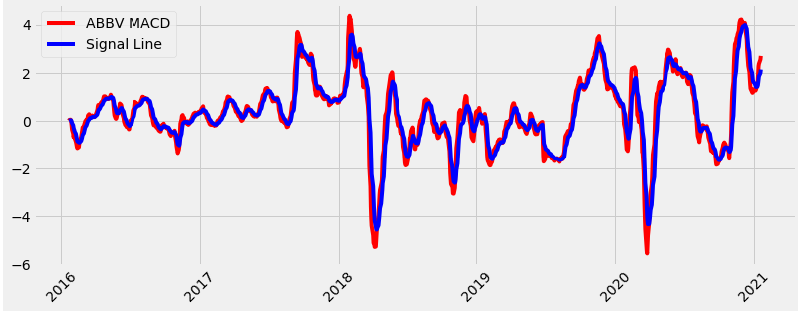
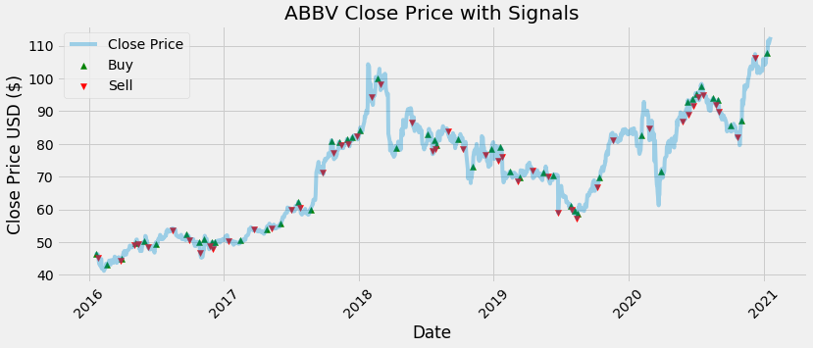
AbbVie Inc (ABBV)
MACD Signal Plots

Slide 8
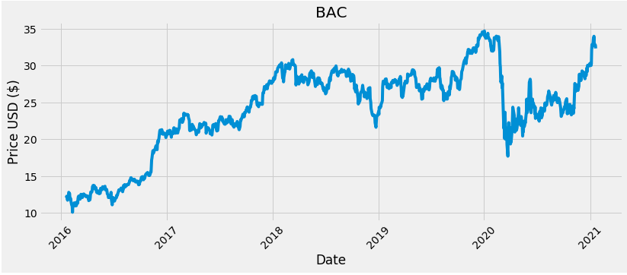
Bank of America Corp (BAC)
Historical Pricing

Slide 9
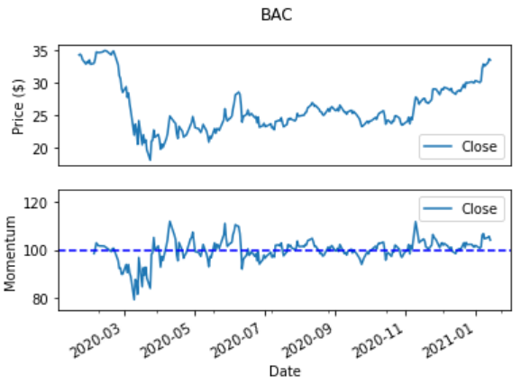
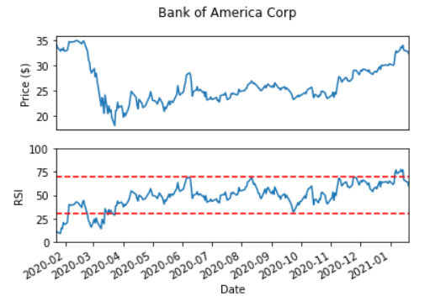
Bank of America Corp (BAC)
Momentum & RSI

Slide 10
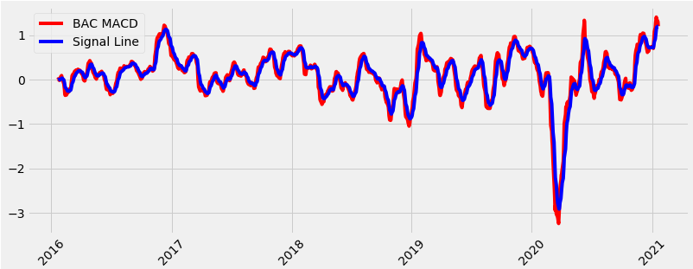
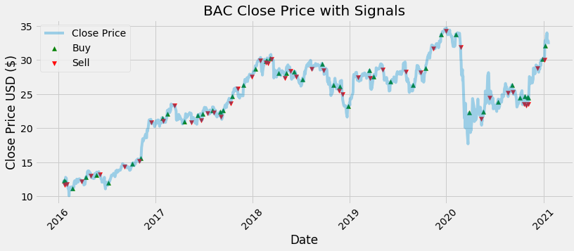
Bank of America Corp (BAC)
MACD Signal Plots

Slide 11

Chevron Corporation (CVX)
Historical Pricing

Slide 12
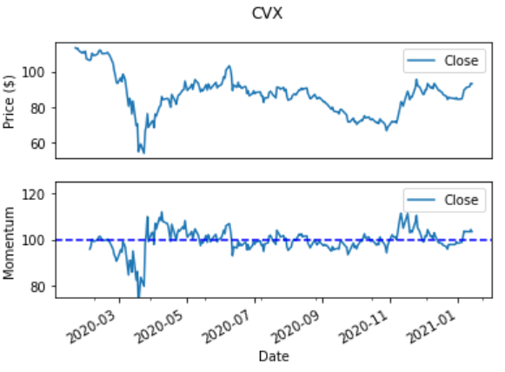
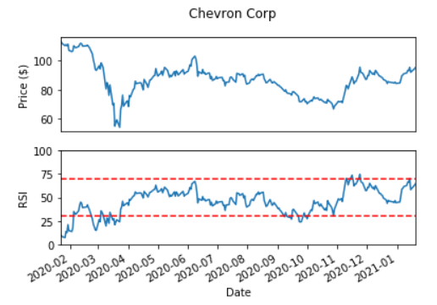
Chevron Corporation (CVX)
Momentum & RSI

Slide 13
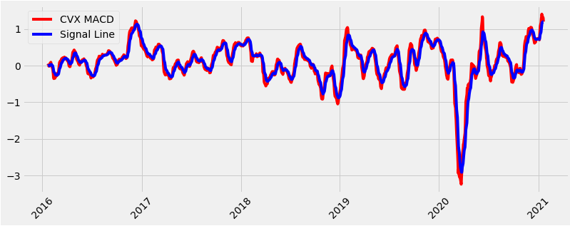
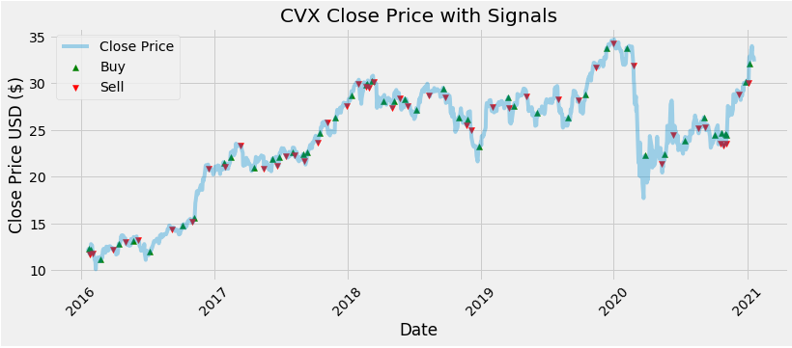
Chevron Corporation (CVX)
MACD Signal Plots

Slide 14
Machine Learning
Testing & Training
We used the data from 2016 – 2019 to train the model, and tested it based on the data from 2020

Slide 15
Testing & Training Data
Insert image of code?

Slide 16
Predictions
Insert image of code?

Slide 17
Results

